Slide 1

STUDIES ON STRUCTURE-ACTIVITY RELATIONSHIPS OF SOME ACTIVATED ALKENES
SUPERVISOR
DR K.RADHAKRISHNAN
ASSOCIATE PROFESSOR
PG AND RESEARCH DEPARTMENT OF CHEMISTRY
SARASWATHI NARAYANAN COLLEGE
MADURAI-22

Slide 2
CHAPTER I
INTRODUCTION

Slide 3
CHAPTER I
CORRELATION ANALYSIS
For summarizing and analyzing the huge data involves the use of empirical correlations by which the results can be related to another. The data may thus be analyzed to reveal the fundamental factors underlying organic chemistry.
Empirical correlations of the reactivities of organic compounds are usually linear relationships involving logarithms of rate k or equilibrium K constants. These relationships are numerous and important that the term linear free-energy relationships (LFER)
is very often used to cover the whole field of correlation analysis in organic chemistry.

Slide 4
CHAPTER I
THE HAMMETT EQUATION
log k/ k_{o} = ρσ
log K/ K_{o} = ρσ
k and K are the rate and equilibrium constants for meta- or para substituted benzene derivatives
k_{o} and K_{o} are the rate constant and equilibrium constants for unsubstituted benzene derivatives

Slide 5
CHAPTER 1 INTRODUCTION
σ - substituent constant measures the polar effect relative to hydrogen as a substituent in
the meta- or para- position and is independent of the reaction.
ρ – reaction constant and measures the susceptibility of the reaction to polar effects
depends on the nature of the reaction.

Slide 6
CHAPTER I INTRODUCTION
DUAL SUBSTITUENT PARAMETER TREATMENT (TAFT’S DSP)
log (k/k_{o}) = ρ_{I} σ_{I} + ρ_{R} σ_{R}
σ_{I} - _{Inductive substituent constant}
σ_{R} - _{Resonance substituent constant}

Slide 7
CHAPTER I INTRODUCTION
YUKAWA-TSUNO EQUATION
log k/ k_{o} = ρ[σ + r (σ⁺ - σ ) ]
for more electron demanding than the ionization of benzoic acids
(σ⁺ - σ ) scale of enhanced resonance effect; r-proportionality constant
log k/ k_{o} = ρ[σ +r (σ⁻ - σ ) ]
for less electron demanding than the ionization of benzoic acids
(σ⁻ - σ ) scale of enhanced resonance effect; r-proportionality constant

Slide 8
CHAPTER I INTRODUCTION
ortho-Effect
log (k/k_{o}) = ρ* σ _{o}* + δ E_{s}
σ _{o}* is the ortho-substituent constant
E_{s} is the steric substituent constant
δ is the susceptibility constant

Slide 9
CHAPTER I INTRODUCTION
TRIPLE SUBSTITUENT PARAMETER (TSP)
Separation of polar, resonance and steric effect given by Charton
log k = α σ_{I} + β σ_{R} + φ ν + h
α- localized component; β-delocalized component
φ- coefficient of steric; h-intercept
σ_{I} - inductive substituent constant; σ_{R} - resonance substituent constant
ν-steric parameter

Slide 10
SCOPE OF THE PRESENT WORK
CORRELATION WITH SPECTROSCOPIC DATA
CORRELATION WITH INHIBITION ZONE
CORRELATION WITH E_{p} and E_{p}^{1/2}

Slide 11
CHAPTER 2
EXPERIMENTAL SECTION

Slide 12
CHAPTER 2 EXPERIMENTAL SECTION
Preparation of 4′-substituted 2-benzylidene-1,3-indandiones

Slide 13
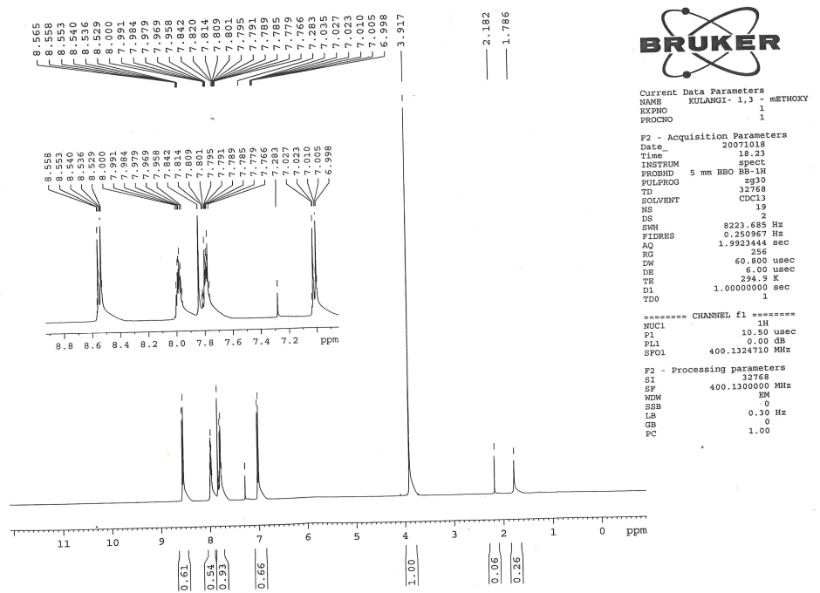

¹H NMR spectra of 2-(4′-Methoxybenzylidene)-1,3-indandione

Slide 14
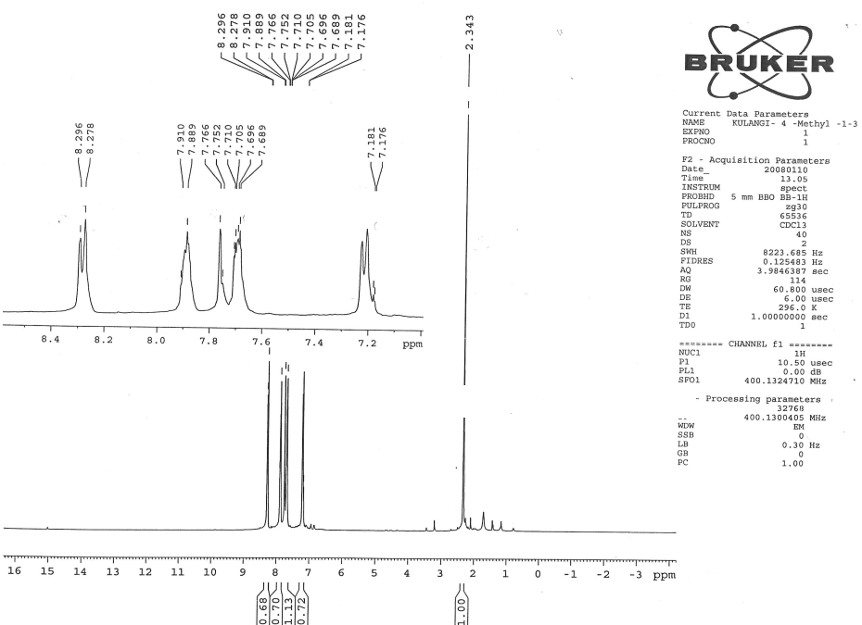
¹H NMR spectra of 2-(4′-Methylbenzylidene)-1,3-indandione

Slide 15
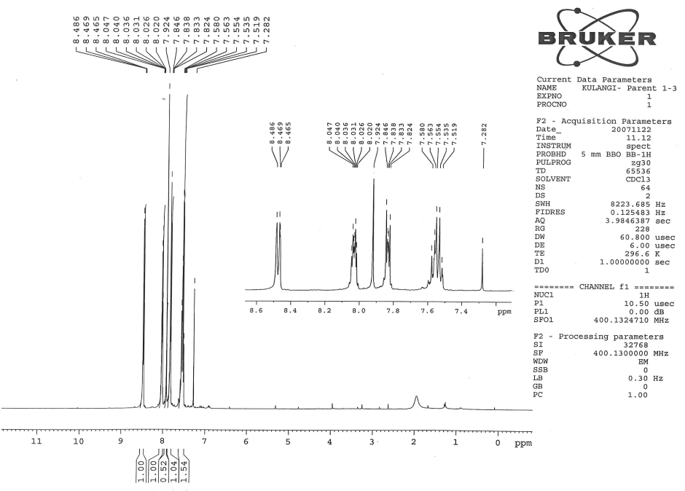
¹H NMR spectra of 2-benzylidene-1,3-indandione

Slide 16
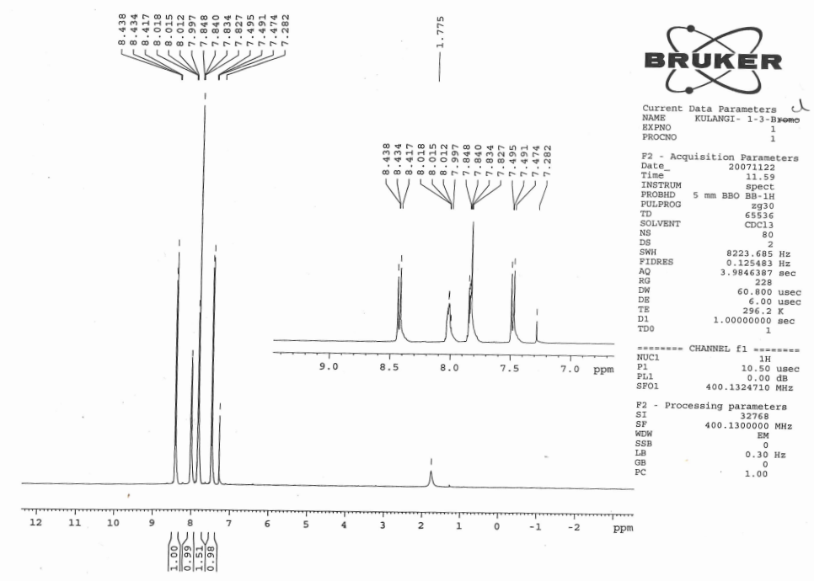
¹H NMR spectra of 2-(4′-Chlorobenzylidene)-1,3-indandione

Slide 17
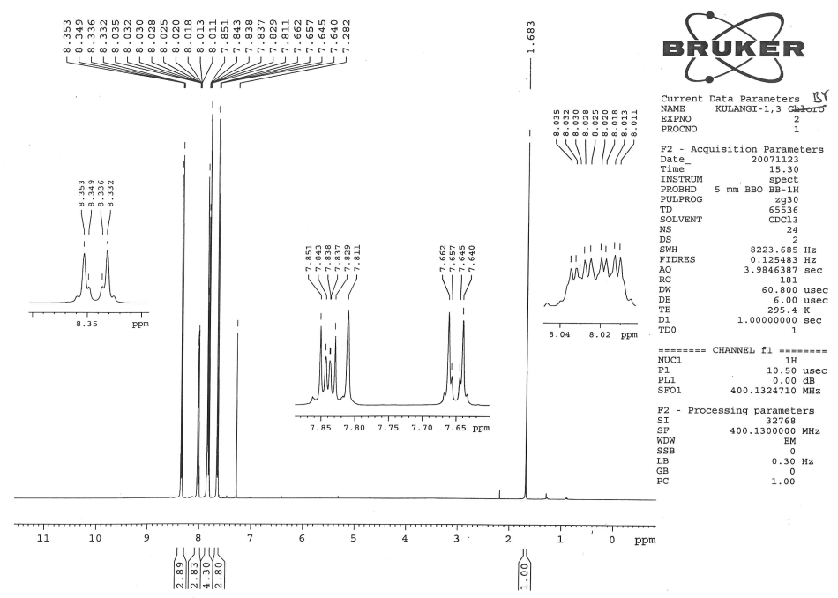
¹H NMR spectra of 2-(4′-Bromobenzylidene)-1,3-indandione

Slide 18
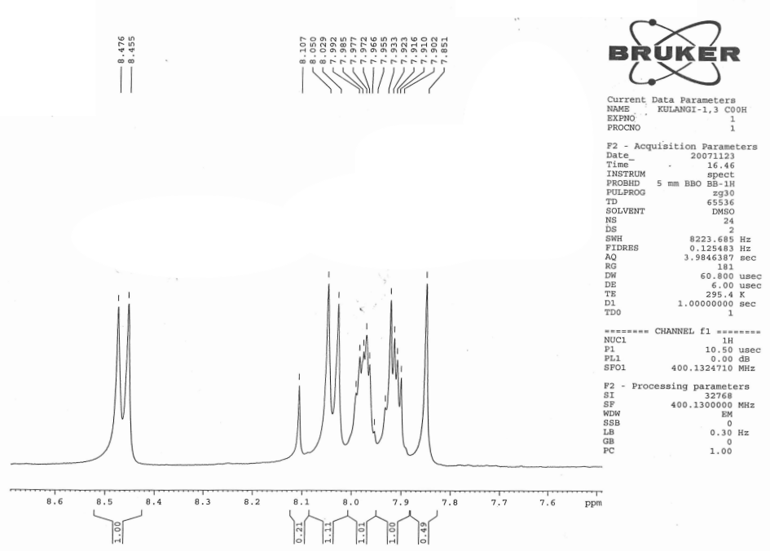
¹H NMR spectrum of 2-(4′-carboxybenzylidene)-1,3-indandione

Slide 19
¹H NMR chemical shift data for 2-benzylidene-1,3-indandiones
2-(4′-Methoxybenzylidene)-1,3-indandione: δ 3.917(s,3H), 6.998-7.027(m,2H), 7.766-7.842(m,2H),
7.842(s,1H),7.958-8.000(m,2H), 8.529-8.558(m,2H).
2. 2-(4′-Methylbenzylidene)-1,3-indandione: δ 2.343(s,3H), 7.178(d,2H), 7.689 - 7.710(m,2H),
7.766(s,1H),7.899(dd,1H), 8.287(d,1H).
3. 2-Benzylidene-1,3-indandione: δ 7.519-7.580(m,4H), 7.824-7.846(m,2H), 7.9249(s,1H),
8.020-.8047(m,2H), 8.465-8.4869(dd,2H).
4. 2-(4′-Chlorobenzylidene)-1,3-indandione: δ 7.474-7.495(m,2H), 7.834-7.848(m,2H), 7.827(s,1H),
7.997- 8.018(m,2H), 8.417-8.438(m,2H).
5. 2-(4′-Bromobenzylidene)-1,3-indandione: δ 7.640-7.662(dd,2H), 8.322-8.353(dd,2H), 7.811(s,1H),
8.011- 8.035(m,2H), 7.829-7.851(m,2H).
6. 2-(4′-Carboxybenzylidene)-1,3-indandione: δ 7.851(s,1H), 7.902-7.923(m,2H), 7.955-7.992(m,2H),
8.039(d,2H), 8.465(d,2H).

Slide 20
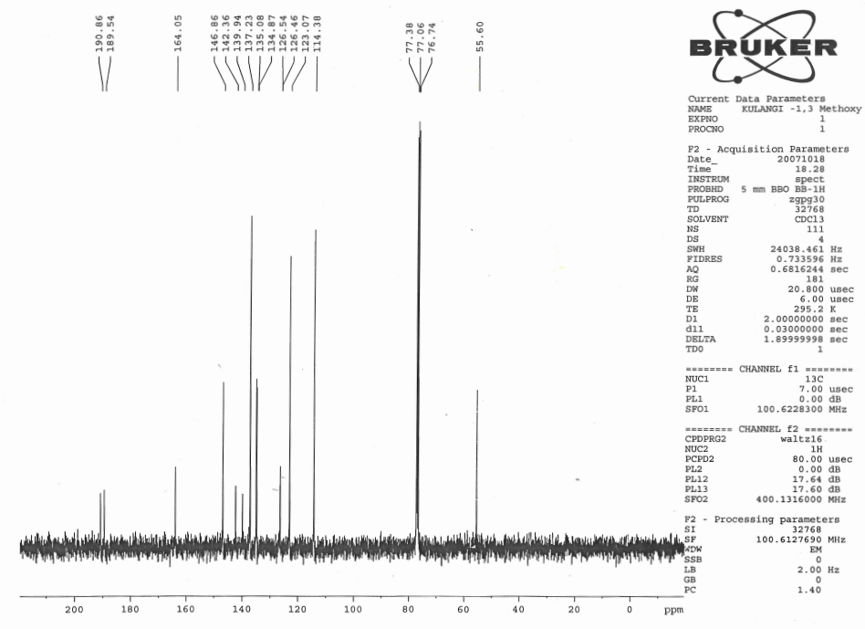
¹³C NMR spectrum of 2-(4′-methtoxybenzylidene)-1,3-indandione

Slide 21
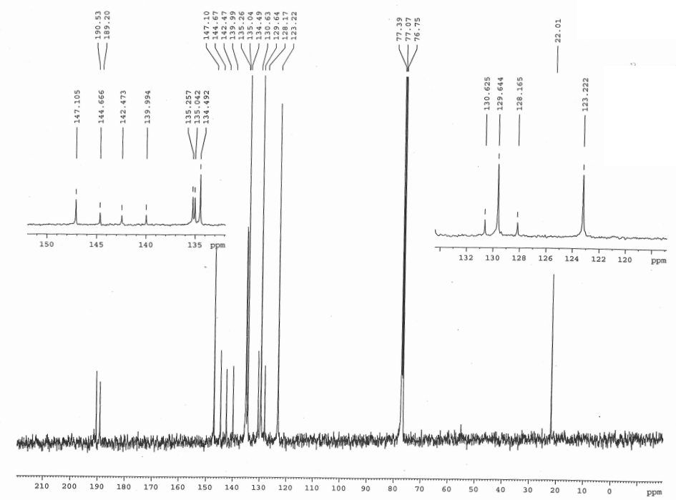
¹³C NMR spectrum of 2-(4′-methylbenzylidene)-1,3-indandione

Slide 22
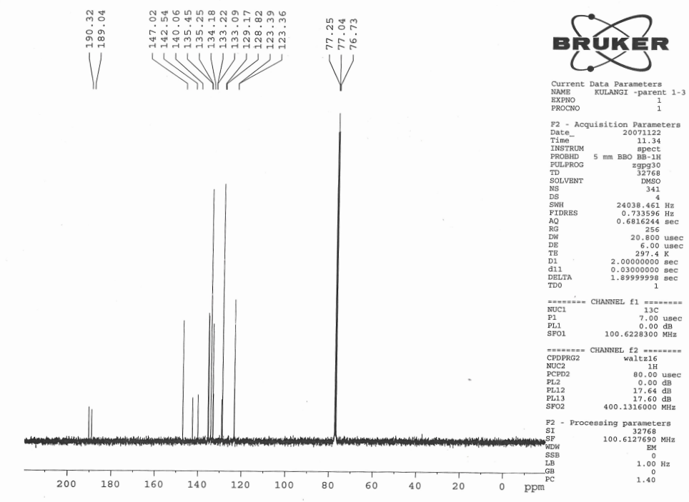
¹³C NMR spectrum of 2-benzylidene-1,3-indandione

Slide 23
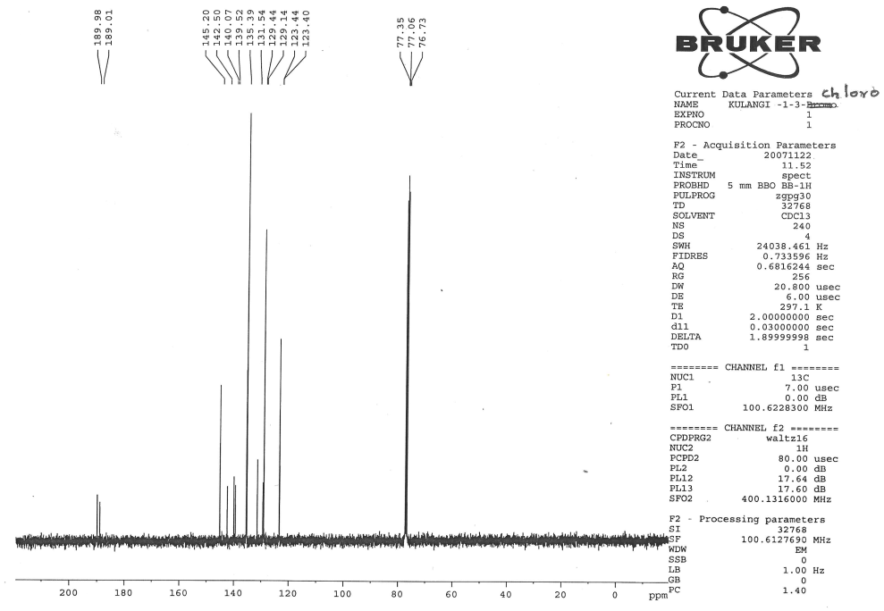
¹³C NMR spectrum of 2-(4′-chlorobenzylidene)-1,3-indandione

Slide 24
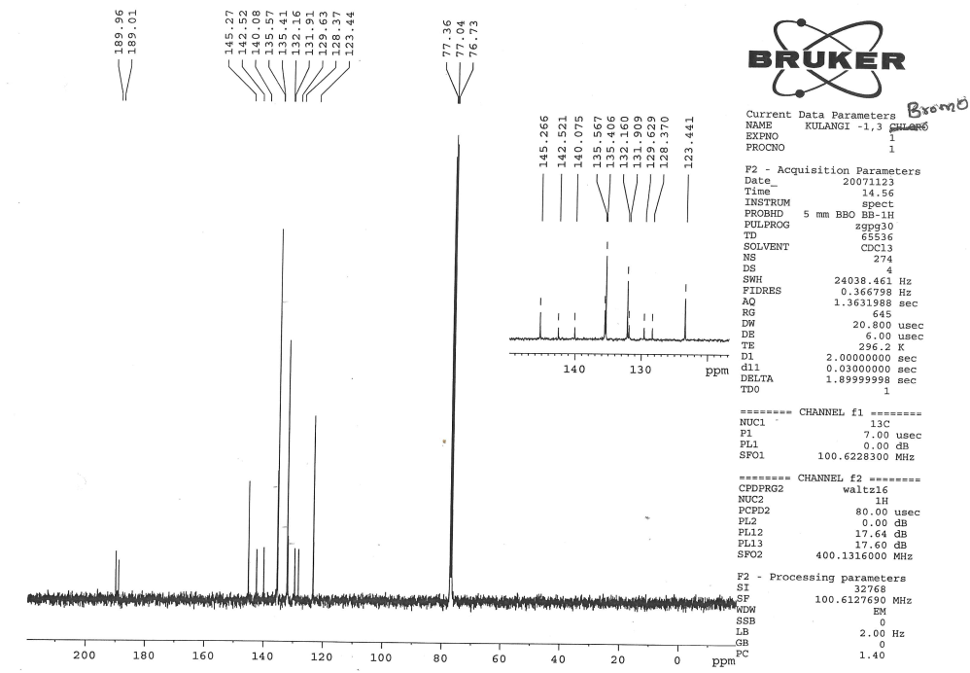
¹³C NMR spectrum of 2-(4′-bromobenzylidene)-1,3-indandione

Slide 25
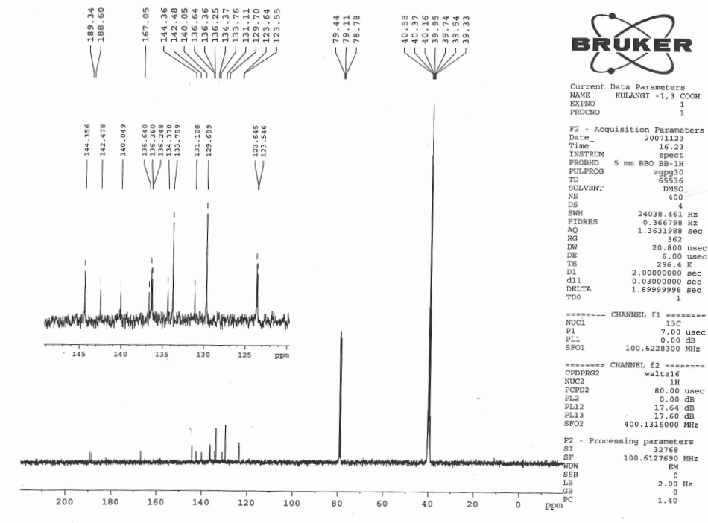
¹³C NMR spectrum of 2-(4′-carboxybenzylidene)-1,3-indandione

Slide 26
¹³C NMR spectral data of 4′-substituted 2-benzylidene-1.3-indandiones
1. 2-(4′-Methtoxybenzylidene)-1,3-indandione: δ 55.60, 114.38, 123.07, 126.46, 126.54,
134.87, 135.08, 137.23, 139.94, 142.36, 146.86, 164.05, 189.54, 190.86.
2. 2-(4′-Methylbenzylidene)-1,3-indandione: δ 22.01, 123.22, 128.17, 129.64, 130.63,
134.49, 135.04, 135.26, 139.99, 142.47, 144.67, 147.10, 189.20, 190.53.
3. 2-Benzylidene-1,3-indandione: δ 123.36, 123.39, 128.82, 129.17, 133.09, 133.22, 134.18,
135.25, 135.45, 140.06, 142.54, 147.02, 189.04, 190.32.
4. 2-(4′-Chlorobenzylidene)-1,3-indandione: δ 123.40, 123.44, 129.14, 129.44, 131.54,
135.39, 139.52, 140.07, 142.50, 145.20, 189.01, 189.98.
5. 2-(4′-Bromobenzylidene)-1,3-indandione: δ 123.44, 128.37, 129.63, 131.91, 132.16,
135.41, 135.57, 140.08, 142.52, 145.27, 189.01, 189.96.
6. 2-(4′-Carboxybenzylidene)-1,3-indandione: δ 123.55, 123.64, 129.70, 131.11, 133.76,
134.37, 136.25, 136.36, 136.64, 140.05, 142.48, 144.36, 167.05, 188.60, 189.34.

Slide 27
CHAPTER 2 EXPERIMENTAL SECTION
Preparation of 4′-substituted 5-benzylidenebarbituric acids.

Slide 28
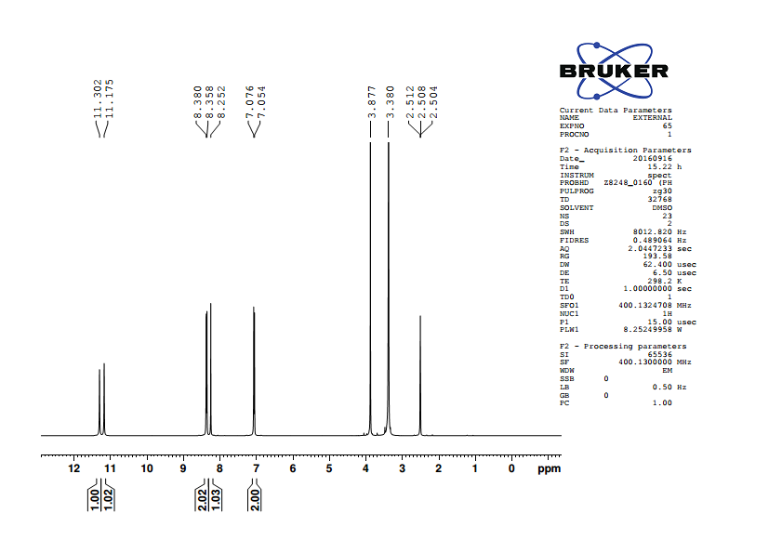
¹H NMR spectrum of 5-(4′-methoxybenzylidene)barbituric acid

Slide 29
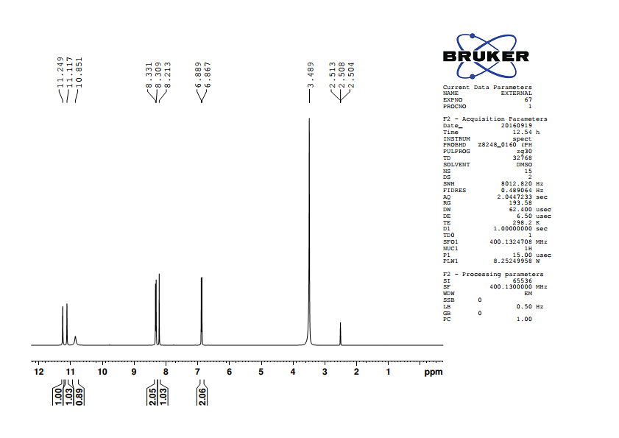
¹H NMR spectrum of 5-(4′-hydroxybenzylidene)barbituric acid

Slide 30
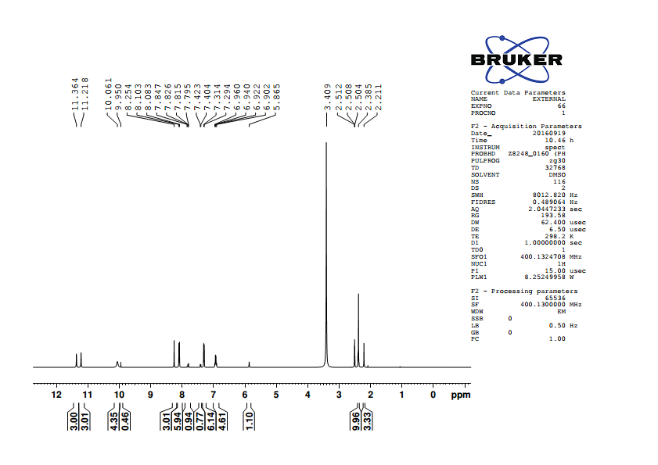
¹H NMR spectrum of 5-(4′-methylbenzylidene)barbituric acid

Slide 31
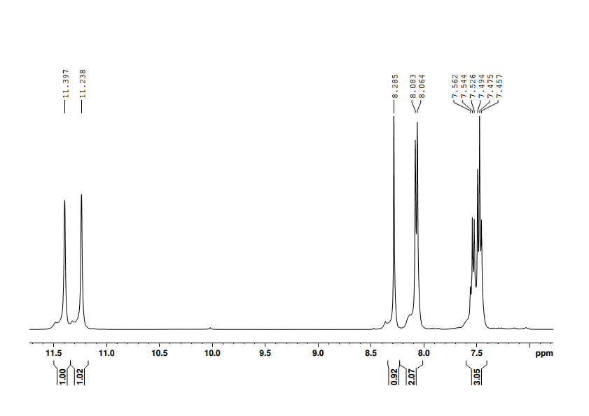
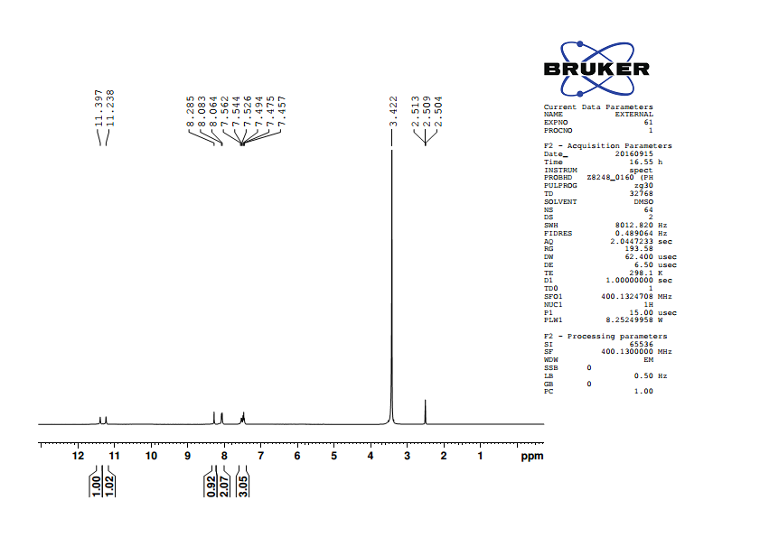
¹H NMR spectrum of 5-benzylidenebarbituric acid

Slide 32

¹H NMR spectrum of 5-(4′-chlorobenzylidene)barbituric acid

Slide 33
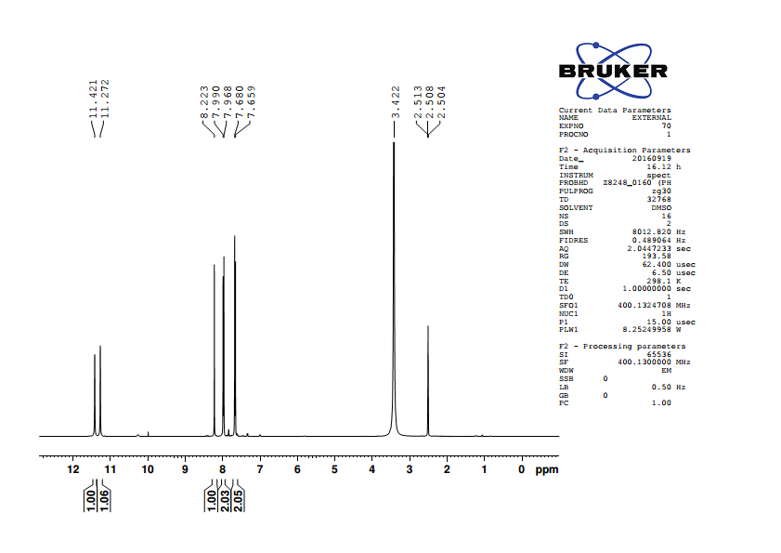
¹H NMR spectrum of 5-(4′-bromobenzylidene)barbituric acid

Slide 34
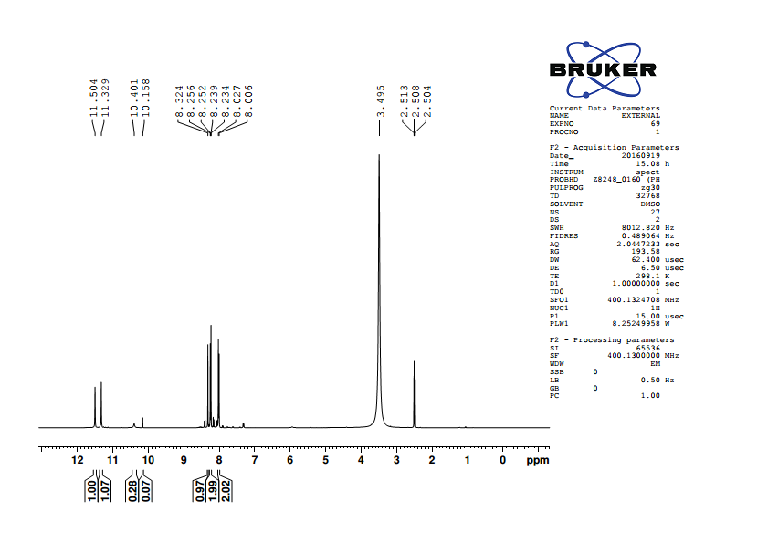
¹H NMR spectrum of 5-(4′-nitroobenzylidene)barbituric acid

Slide 35
¹H NMR Spectral data of 4′-substituted 5-benzylidenebarbituric acids
1. 5-(4′-Methoxybenzylidene)barbituric acid
δ 3.877 (s,3H), 7.065 (d,2H), 8.252(s,1H), 8.369 (d,2H), 11.175 (s,1H), 11.302 (s,1H).
2. 5-(4′-Hydroxybenzylidene)barbituric acid
δ 6.878 (d,2H), 8.213 (s,1H), 8.320 (d,2H), 10.851 (s,1H), 11.117(s,1H), 11.249 (s,1H).
3. 5-(4′-Methylbenzylidene)barbituric acid
δ 2.385 (s,3H), 7.304 (d,2H), 8.094 (d,2H), 8.255 (s,1H), 11.218 (s,1H), 11.365 (s,1H).
4. 5-Benzylidenebarbituric acid
δ 7.485 (m,3H), 8.073 (d,2H), 8.285 (s,1H), 11.238 (s,1H), 11.397 (s,1H).
5. 5-(4′-Chlorobenzylidene)barbituric acid
δ 7.518 (d,2H), 8.069 (d,2H), 8.243 (s,1H), 11.275 (s,1H), 11.425 (s,1H).
6. 5-(4′-Bromobenzylidene)barbituric acid
δ 7.670 (d,2H), 7.979 (d,2H), 8.223 (s,1H), 11.272 (s,1H), 11.421 (s,1H).
7. 5-(4′-Nitrobenzylidene)barbituric acid
δ 8.017 (d,2H), 8.245 (d,2H), 8.324 (s,1H), 11.329 (s,1H), 11.504 (s,1H).

Slide 36
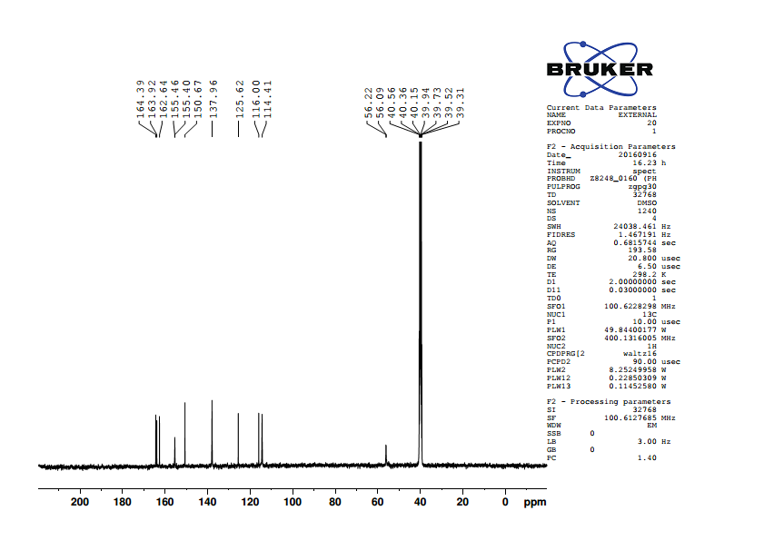
¹³C NMR spectrum of 5-(4′-methoxybenzylidene)barbituric acid

Slide 37

¹³C NMR spectrum of 5-(4′-hydroxybenzylidene)barbituric acid

Slide 38
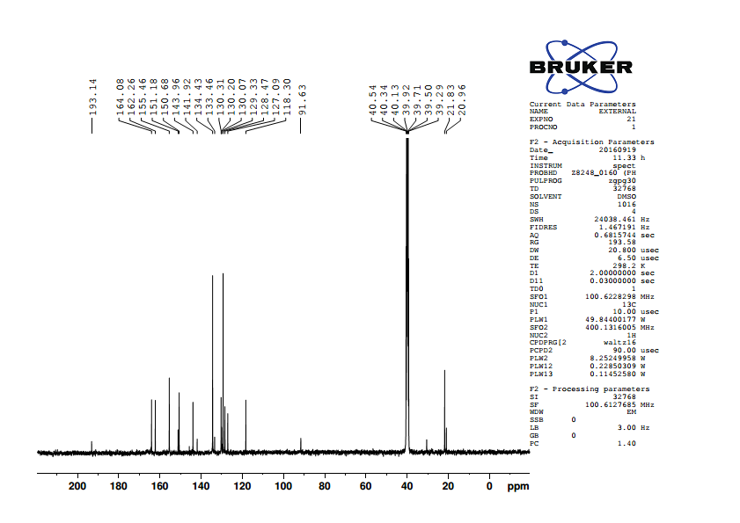
¹³C NMR spectrum of 5-(4′-methylbenzylidene)barbituric acid

Slide 39
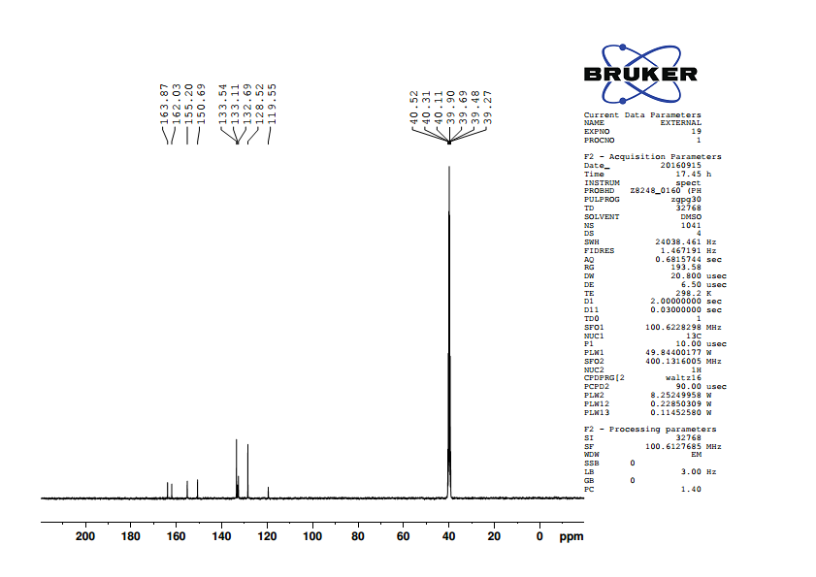
¹³C NMR spectrum of 5-benzylidenebarbituric acid

Slide 40

¹³C NMR spectrum of 5-(4′-chlorobenzylidene)barbituric acid

Slide 41

¹³C NMR spectrum of 5-(4′-bromobenzylidene)barbituric acid

Slide 42
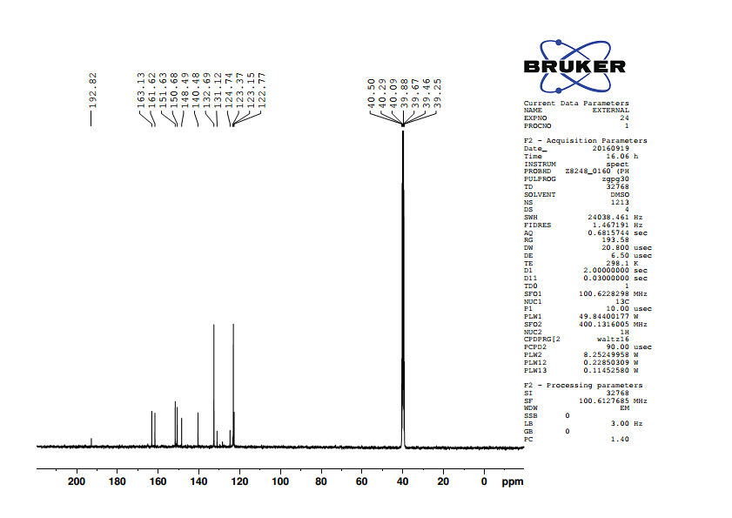
¹³C NMR spectrum of 5-(4′-nitrobenzylidene)barbituric acid

Slide 43
¹³C NMR Spectral data of 4′-substituted 5-benzylidenebarbituric acids
1. 5-(4′-Methoxybenzylidene)barbituric acid
δ 56.22, 114.41, 116.00, 125.62, 137.96, 150.67, 155.46, 162.64, 163.92, 164.39.
2. 5-(4′-Hydroxybenzylidene)barbituric acid
δ 114.61, 115.97, 124.24, 138.77, 150.70, 156.05, 162.75,163.48, 164.59.
3. 5-(4′-Methylbenzylidene)barbituric acid
δ 118.30, 129.33, 130.31, 134.43, 143.96, 150.68, 155.46, 162.26, 164.08.
4. 5-Benzylidenebarbituric acid
δ 119.55, 128.52, 132.69, 133.11, 133.54, 150.69, 155.20, 162.03, 163.87.
5. 5-(4′-Chlorobenzylidene)barbituric acid
δ 120.09, 128.55, 132.01, 135.15, 137.21, 150.65, 153.52, 162.04, 163.67.
6. 5-(4′-Bromobenzylidene)barbituric acid
δ 120.24, 126.29, 131.51, 132.40, 135.15, 150.65, 153.56, 162.04, 163.67.
7. 5-(4′-Nitrobenzylidene)barbituric acid
δ 123.15, 123.37, 132.69, 140.48, 148.49, 150.68, 151.63, 161.62, 163.13.

